Slide 1

Sardar Vallabhbhai Patel Institute Of Technology
TOPIC :- “BANKING”
NAME :- VISHAL BHADJA
SUBJECT :- E.E.M.
ENROLLMENT NO. :- 160410116011
FACUALTY NAME :- PROF. DISHA PATEL

Slide 2
CONTENTS
KEY TERMS OF BANKING
DEFINITION
ROLE OF BANK
TYPES OF BANK
BANKING STRUCTURE IN INDIA
CURRENT ASSETS
CURRENT SHARE HOLDER EQUITY

Slide 3
DEFINATION
Banking: “ The banks are the institutions which deals in the money.”
“A bank is a specialized intermediary institution authorized by the government to accept deposit from the public and advancing the same money to the needy sector at higher rate.”

Slide 4
ROLE OF BANKS
Payment system
Pay deposits on demand
Payment through cheques
Facilitate movement of money
Circulatory system of the economy
Financial services provider
Products of mutual funds &insurance companies
 Collection of utility bills

Slide 5
The Business of Banking
The banking industry includes:
commercial banks,
savings and loans, and,
credit unions.
Banks are profit-seeking institutions:
Banks accept deposits and use part of
them to extend loans and make investments. Income from these activities is their major source of revenue.

Slide 6
How Banks Create Money by Extending Loans
More than 97% of all the money in the Economy exists as bank Deposits and bank create these deposits simply by making Loans.
Every time someone takes out a loan, new money is created so most the money in our economy is made up of bank deposits.
The reserve requirement arises with the creation of the deposit (the bank’s liability) while the capital requirement arises with the creation of the loan (the bank’s asset) so loan create capital requirement, deposit create reserve requirements.

Slide 7
TYPES OF BANKS
➢Commercial bank
➢Government bank
➢Private bank
➢Saving bank
➢Cooperative bank
➢Investment bank
➢Specialized bank

Slide 8
COMMERCIAL BANK
It helps to mobilize the saving of the community.
To make them available to the entrepreneurs.
To ensure safety with liquidity.
Bank assures all the funds can be drawn back in case of
Need.

Slide 9
Functions of
Commercial Banking
Banks provide services and pay interest to attract checking, savings, and time deposits (liabilities).
Most of these deposits are invested and loaned out, providing interest income for the bank.
Banks hold a portion of their assets as reserves (either
As cash or deposits with the Fed) to meet their daily obligations toward their depositors.

Slide 10
Commercial bank in india
1950- 645 banks and 4,800 branch office
1969- 14 major commercial bank is nationalized
1993- 2 more bank merged
At present- 19 nationalized bank in india

Slide 11
DRAWBACK OF COMMERCIAL BANK
Growth is less
Regional imbalance
Quality service is poor
No proper experts to improve public sectors banks

Slide 12
Government bank
➢Government has a major stake
usually need to emphasize on social objectives
than on profitability.
Central bank , RBI
Private bank
Owned, managed and controlled by private promoters
➢Free to operate as per market forces .

Slide 13
Investment banking
Financial institution that assists individuals, corporations and governments example - M&T bank
Cooperative bank
Governed by the provisions of State Cooperative Societies Act
i.e., agricultural financing bank in India.

Slide 14
CENTRAL BANK
Other banks are largely profit seeking institutions ,the Central bank is not.
It acts as the organ of the state.
Other bank have largely public dealing ,the central bank’s dealing are with governments, central & state banks & other financial institutions.

Slide 15
BANKING STRUCTURE IN INDIA
The state bank of india & its associated banks
Others nationalized banks
Regional rural banks
Private sectors commercial banks
Foreign banks

Slide 16
FUNCTION OF RBI
Issue of currency
Bankers to the government
Bankers bank
Custodian of foreign exchange reserve
Controller of credit
Promotional function
Collection & publication of data

Slide 17
Current assets of top 5 bank in world
State | BANKS | Assets
Switzerland | USB | 1533 billion
United state | Citi group | 1484 Billion
Japan | UFJ | 1296 Billion
United kingdom | HSBC | 1277 Billion
France | Credit Agricola group | 1243 Billion

Slide 18
Top 5 banking group in the world by shareholder equity
Country | Company | Share holder equity
United state | Citi group | 112537 $million
United state | JPMorgan chase | 107211 $million
United state | Bank of America | 101224 $million
United kingdom | HSBC | 98226 $million
Japan | UFG | 83281 $million

Slide 19
Case study : ICICI BANK
ICICI Bank, stands for Industrial Credit and Investment Corporation of India,is an Indian multinational banking and financial services company headquartered in Mumbai, Maharashtra, India. with its registered office in Vadodara. In 2014, it was the second largest bank in India in terms of assets and third in term of market capitalization. It offers a wide range of banking products and financial services for corporate and retail customers through a variety of delivery channels and specialized subsidiaries in the areas of investment banking, life, non-life insurance, venture capital and asset management. The bank has a network of 4,850 branches and 14,404 ATMs in India, and has a presence in 19 countries including India.

Slide 20


Slide 21
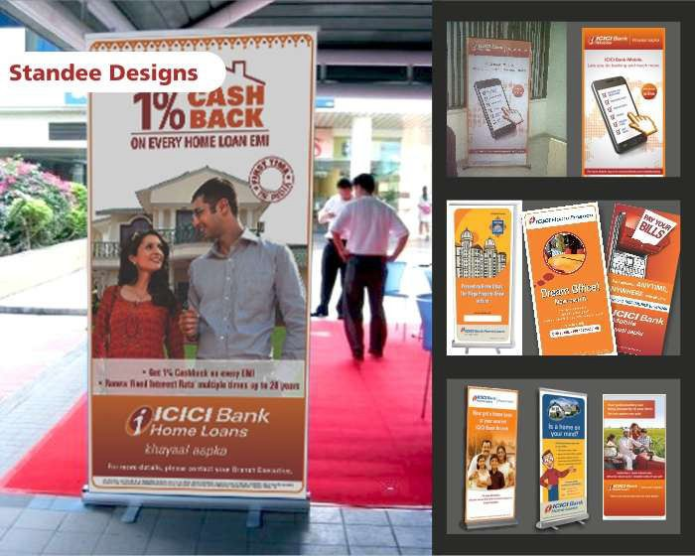
The real challenge in developing communication for such a large brand lies in creating something that is easy to understand, universal and consistent with the brand
image. You must have notice
my most recent work on
ICICI Bank Home Loans
for their All India “1% cash back” offer Campagins.

Slide 22

iWish- the flexible recurring deposit
iWish is a flexible recurring deposit product launched by ICICI Bank for its savings account customers. Unlike a traditional recurring deposit, iWish allows customers to save varying amounts of money at any time of their choice. Customers can create several goals and track their progress on an online interface.
ICICI Bank has developed this product in collaboration with Social Money. ICICI Bank has also launched an app for Android and Apple Smartphone. The app will provide the facility of online banking transaction from Smartphone.

Slide 23


Slide 24
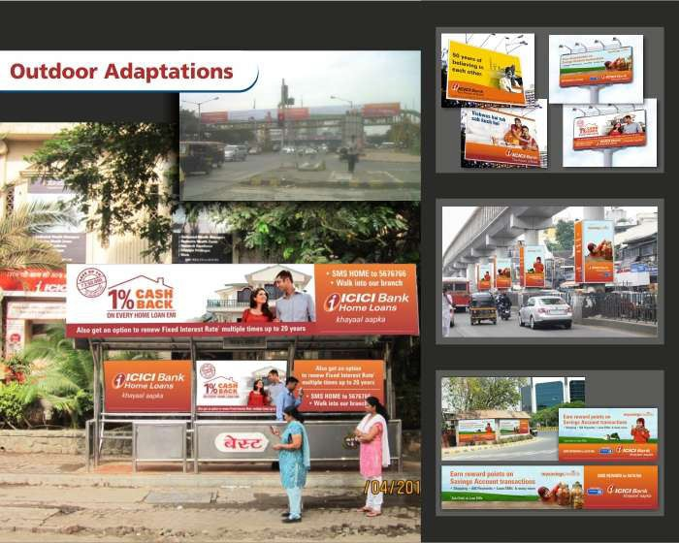
Advertisement campaigns
ICICI Bank has run multiple successful advertising campaigns over the last decade.
2001: Safer, Simpler, Smarter
2003: Hum Hein Na
2005: Opportunities Unlimited
2008: Power of Belief
2012: Khayaal Aapka

Slide 25
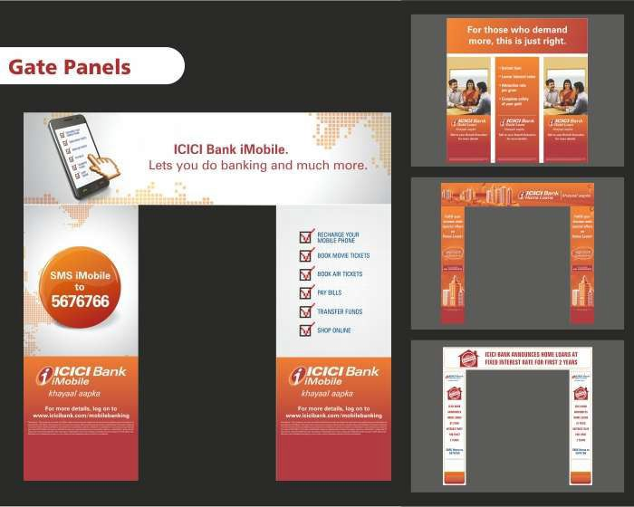

Slide 26

The latest in the series is Khayaal Aapka campaign that was launched in 2012. We will be using this campaign as the focal campaign for all analysis and discussions.

Slide 27

Evidence of advertising campaigns being effective
Millward Brown in its most recent release of the top brands in the world has ranked ICICI at No.63, down a couple of rankings, but highest in all Indian brands. There port states that:

Slide 28
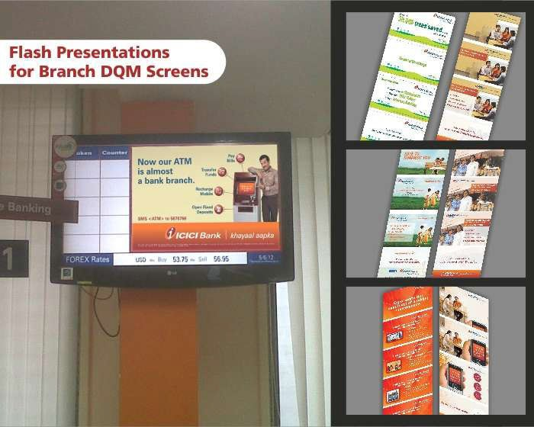
“A major integrated financial institution, with offices worldwide,
ICICI ranks in the BrandZ™ Top 100. ICICI competes with other growing Indian bank brands such as HDFC and Axis Bank. Even in banking, a global brand implies a greater sense of status than a local Indian brand, generally. In practice, however, people in smaller, rural markets may
find that the Indian bank brand understands their needs more deeply. And government regulations may provide regulatory protection for the local brand.”

Slide 29

These types of third party endorsements are evidence of the overall effectiveness of the media campaign.

Slide 30


